Slide 1

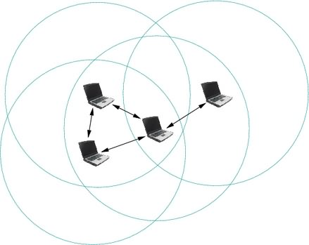
Python for Machine Learning
Presenter:
Shakil Muhammad
KAIST

Slide 2
Why is the python considered as the most favorable language in the machine learning research?

Slide 3
Introduction
Python implementation started in 1989
Python is general purpose Programming Language
Python is scripting as well as programming language
Compiled to perform certain tasks
Script to control other applications / systems
No intermediary
Python are automatically compiled to byte code

Slide 4
Python Features
Balance of High Level and Low-Level Programming
Language Interoperability
Holistic Language Design
Rich Libraries and huge supporting community
Easy to learn, easy to maintain
Portable

Slide 5
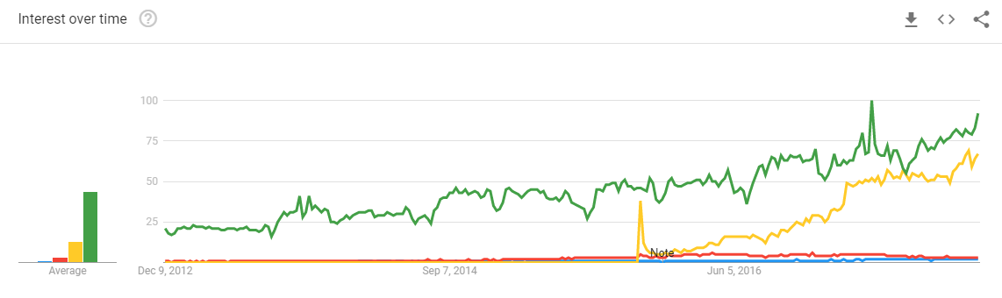
Python ML Libraries
Keras (Commits: 4124, Contributors: 575)
TensorFlow (Commits: 25,550, Contributors: 1180)
Theano (Commits: 27,893, Contributors: 326)
SciKit-Learn (Commits: 22430, Contributors: 980)

Slide 6
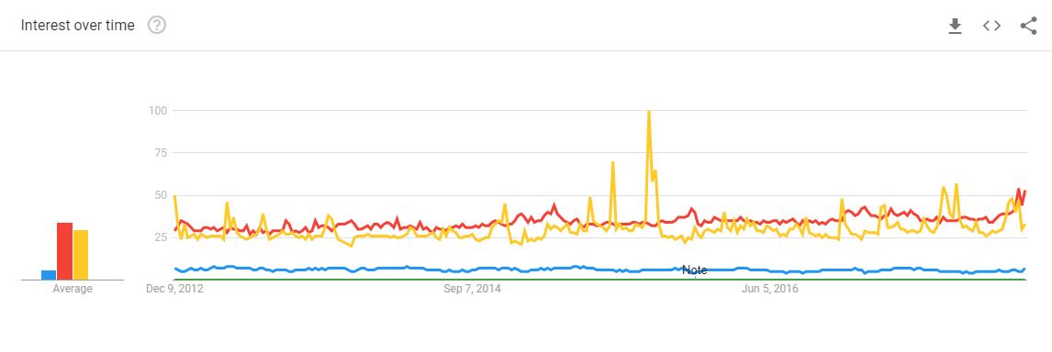
Java ML Libraries
Weka (Commits: 9133, Contributors: 1)
MOA (Commits: 673, Contributors: 24)
SAMOA (Commits: 106, Contributors: 14)
JSAT (Commits: 1450, Contributors: 14)

Slide 7
Opinions
Adam Geitgey, Groupon
Libraries support: scikit-learn, NumPy and pandas
Easy to learn
Low level as well as high level tools
Justin Stoltzfus, freelancer
Easy like playing with toys
Rich Library support
Web blogs / comments
Libraries
Clean code
https://jaxenter.com/python-popular-programming-language-today-machine-learning-128942.html
https://www.techopedia.com/why-is-python-so-popular-in-machine-learning/7/32881
https://ai.stackexchange.com/questions/3494/why-is-python-the-most-popular-language-in-the-ai-field

Slide 8
Thank you
KAIST

